Slide 2

Geometry

Slide 3
what is ?
GEO
Metry

Slide 4
GEO
Metry

Slide 5
GEO
Metry
earth
measurement

Slide 6
(n)
GEO
Metry
A branch of mathematics concerned with the properties and relations of points, lines, surfaces and higher dimensional analogs

Slide 7
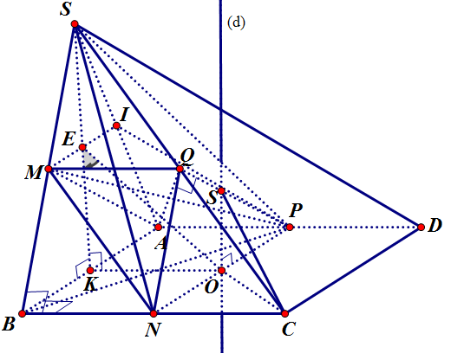
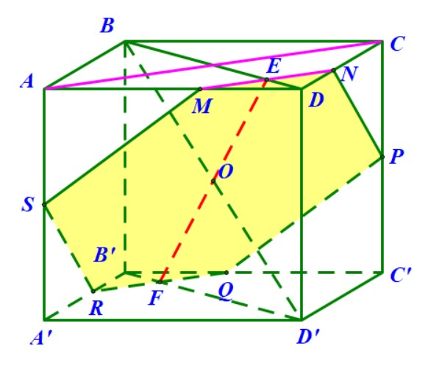
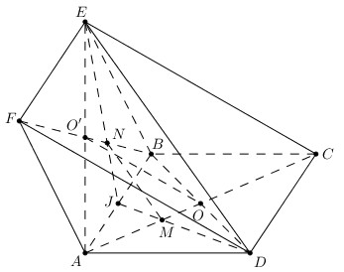
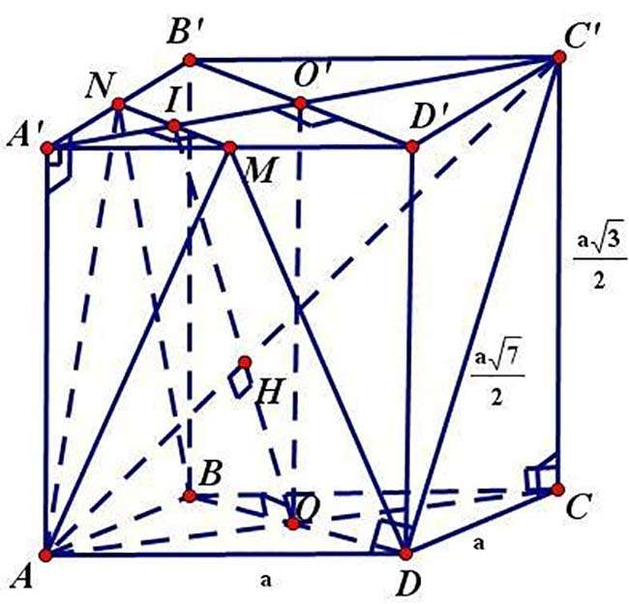
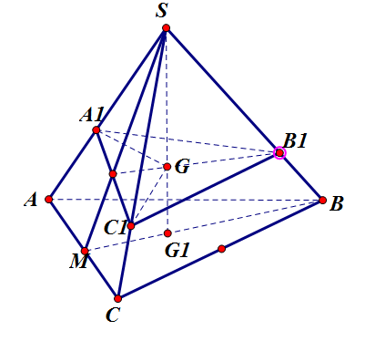

Slide 15
Fundamental of geometry is
POINT

Slide 16
POINT
Line
3D polygon
polygon

Slide 17
POINT
Line
polygon

Slide 18

POINT

Slide 19
what exactly is a point ?

Slide 20
(n)
point
Something having position but not spatial extent, magnitude, dimension, or direction

Slide 21
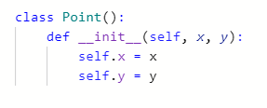
expression

Slide 22
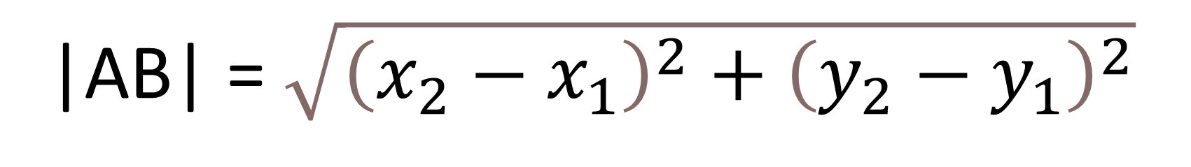

Distance between 2 points
$$A\left(x1;y1\right)$$
$$B\left(x2;y2\right)$$
|AB| = $\sqrt{{\left(x_{2}−x_{1}\right)}^{2}+{\left(y_{2}−y_{1}\right)}^{2}}$

Slide 23

Distance between 2 points

Slide 24
POINT
Line
polygon

Slide 25
line

Slide 26
what is a line ?

Slide 28
a straight set of points
extending in opposite directions
Line
has no end in both directions
one-dimensional

Slide 29
A
a straight set of points
extending in opposite directions
B
bounded by
2 distinct end points
part of a line
contains all points
between its endpoints
Line
has no end in both directions
=> Line segment
one-dimensional

Slide 30
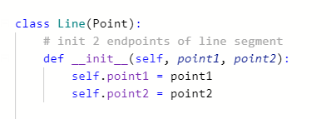
expression

Slide 31
intersection between 2 lines ?

Slide 32
line equation

Slide 33
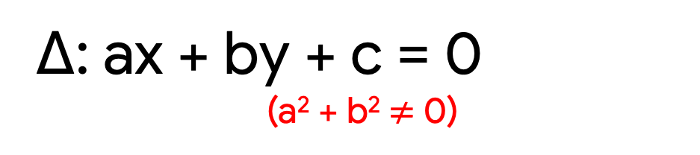
line equation
Δ: ax + by + c = 0
(a² + b² $≠$0)

Slide 34
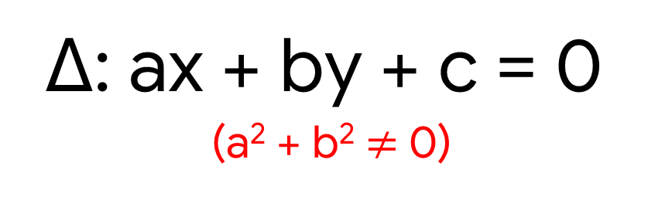
line equation
Δ: ax + by + c = 0
(a² + b² $≠$0)
A(x₁, y₁) and B(x₂, y₂)
a = y₁ - y₂
b = x₂ - x₁
c = - (x₁ * a + y₁ * b)

Slide 35
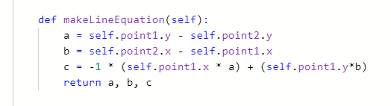
line equation

Slide 36
intersection between 2 lines ?

Slide 37
3 cases

Slide 38
3 cases

Slide 39
intersection
Check if 2 lines intersect
Find the intersect coordinate

Slide 40
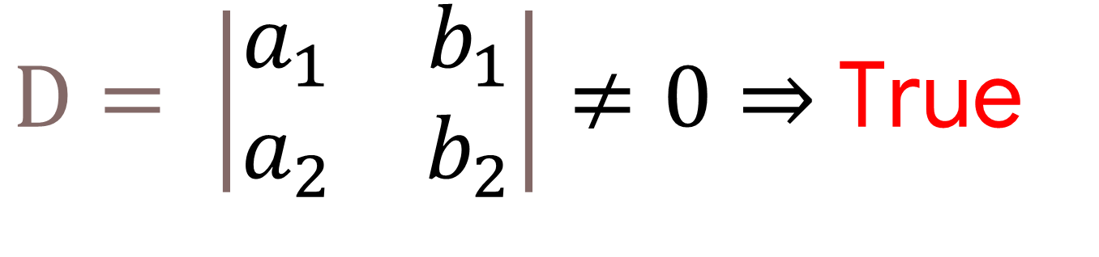

Check if 2 lines intersect
$$\left\{\begin{matrix}\left(d_{1}\right):{ a}_{1}x+b_{1}y+c_{1⋅}=0 \\ \left(d_{2}\right):{ a}_{2}x+b_{2}y+c_{2}=0\end{matrix}\right.$$
$D= \left|\begin{matrix}a_{1} & b_{1} \\ a_{2} & b_{2}\end{matrix}\right|≠0⇒$ True

Slide 41
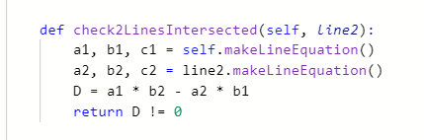
Check if 2 lines intersect

Slide 42
intersection
Check if 2 lines intersect
Find the intersect coordinate

Slide 43
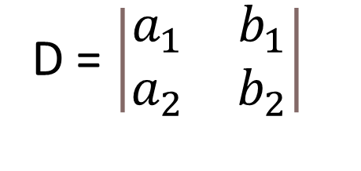
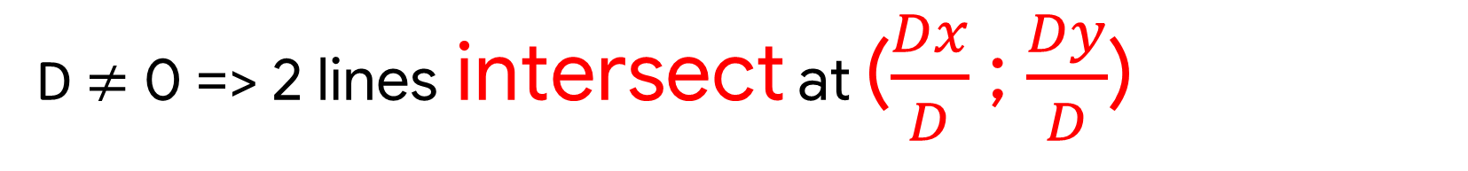

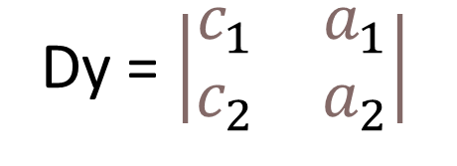
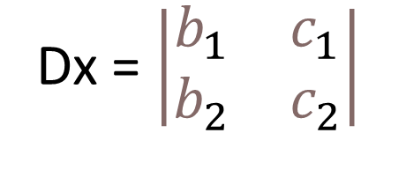
Find the intersect coordinate
$$\left\{\begin{matrix}\left(d_{1}\right):{ a}_{1}x+b_{1}y+c_{1⋅}=0 \\ \left(d_{2}\right):{ a}_{2}x+b_{2}y+c_{2}=0\end{matrix}\right.$$
D = $\left|\begin{matrix}a_{1} & b_{1} \\ a_{2} & b_{2}\end{matrix}\right|$
Dx = $\left|\begin{matrix}b_{1} & c_{1} \\ b_{2} & c_{2}\end{matrix}\right|$
Dy = $\left|\begin{matrix}c_{1} & a_{1} \\ c_{2} & a_{2}\end{matrix}\right|$
D = 0 and (Dx $≠$ 0 or Dy $≠$ 0) => 2 lines are parallel
D $≠$ 0 => 2 lines intersect at ($\frac{Dx}{D}$ ; $\frac{Dy}{D}$)
D = Dx = Dy = 0 => 2 lines coincidence

Slide 44
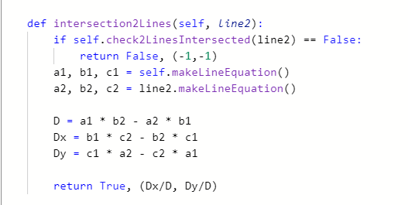
Find the intersect coordinate

Slide 45
a point on a line

Slide 46

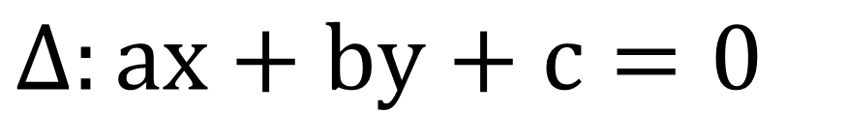
a point on a line
A(x_{A}; y_{A})
$$Δ:ax+by+c=0$$
$A∈Δ$ ????

Slide 47
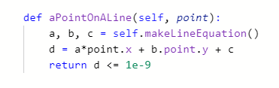
a point on a line

Slide 48
POINT
Line segment
polygon

Slide 49
polygon

Slide 50
What is a polygon ?

Slide 51
polygon
a flat 2D closed shape
straight sides with no curve

Slide 52

expression
a flat 2D closed shape
polygon
straight sides with no curve

Slide 53
How to calculate area of a polygon ?

Slide 54
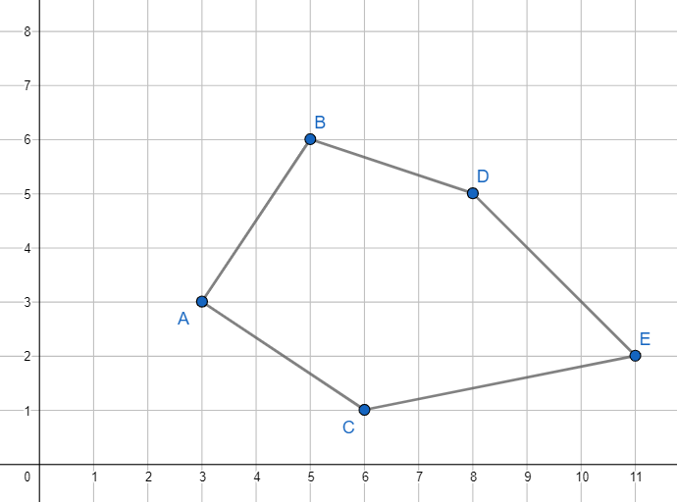

Slide 55
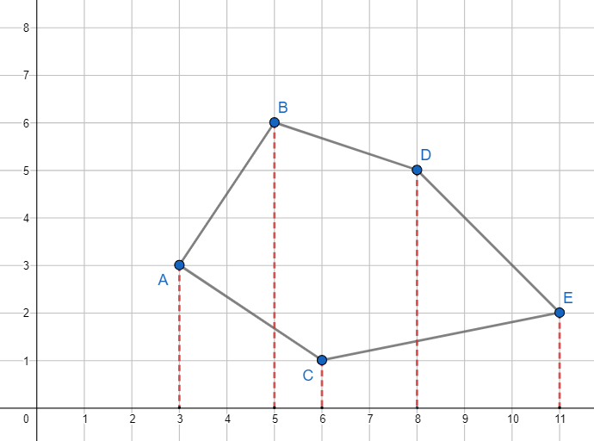

Slide 56
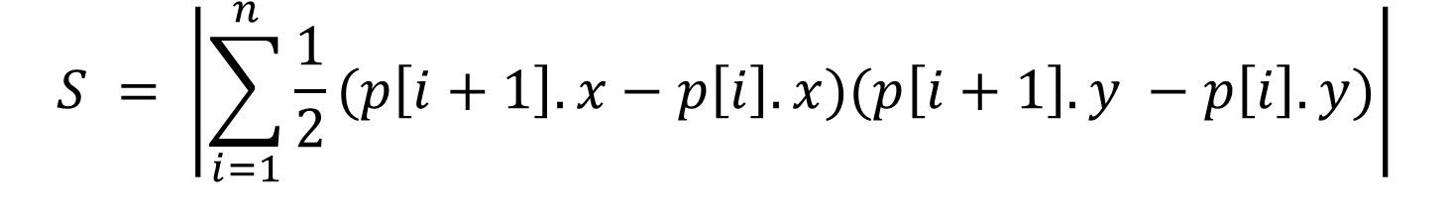
$$S = \left|\sum_{i=1}^{n}{\frac{1}{2}(p\left[i+1\right].x−p\left[i\right].x)(p\left[i+1\right].y −p\left[i\right].y)}\right|$$

Slide 57
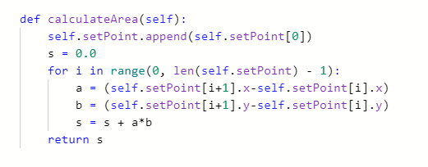

Slide 58
a point inside a polygon

Slide 59
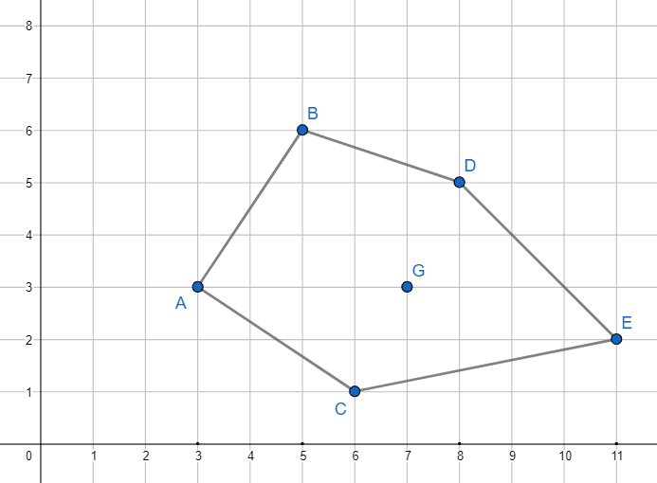
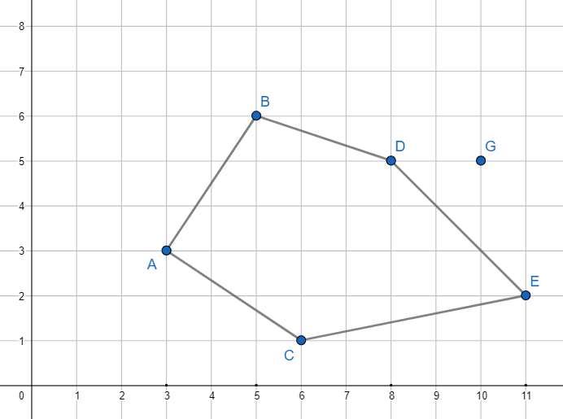
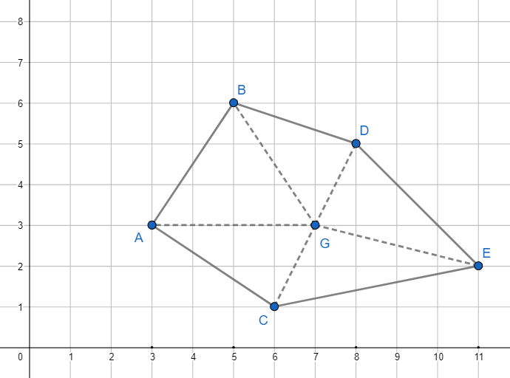

Slide 60
S_{triangles} = S_{polygon} → Point in polygon

Slide 61
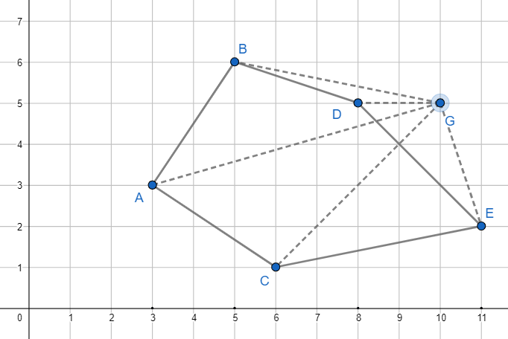

S_{triangles} $≠$ S_{polygon} → Point not in polygon

Slide 62
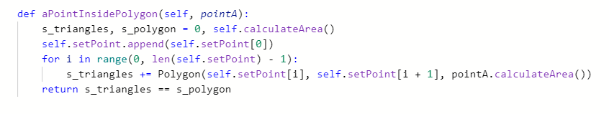

Slide 63
Practice

Slide 64
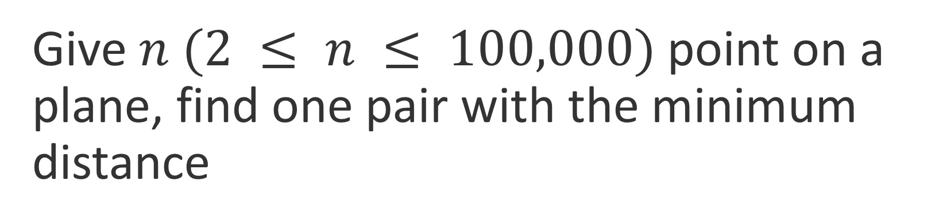
Give $n$ $(2 ≤ n ≤ 100,000)$ point on a plane, find one pair with the minimum distance
Practice

Slide 65
Idea
Divide N points into 2 sets by a straight line
Call recursion to find the nearest pairs of points for both left and right sets
Find the shortest distance between one point from the left set and one from the right

Slide 66
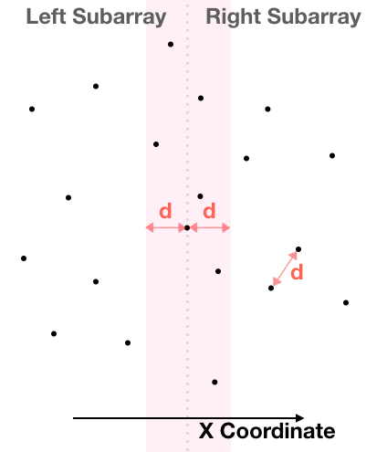
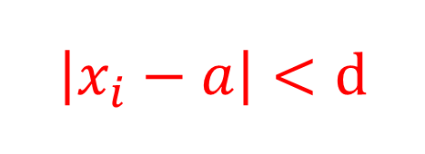
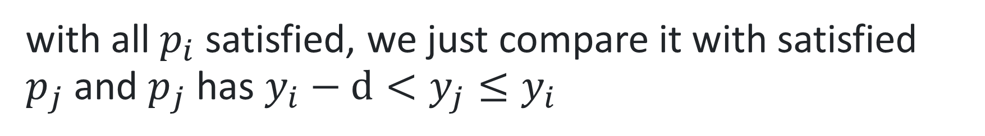
$$\left|x_{i}−a\right|<d$$
O(NlogN)
with all $p_{i}$ satisfied, we just compare it with satisfied $p_{j}$and $p_{j}$ has $y_{i}−d<y_{j}≤y_{i}$

Slide 67

Practice
Gặm cỏ
https://oj.vnoi.info/problem/vmunch

Slide 68
geometry's applications

Slide 69
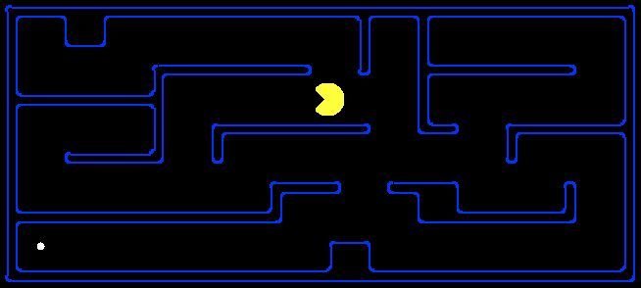
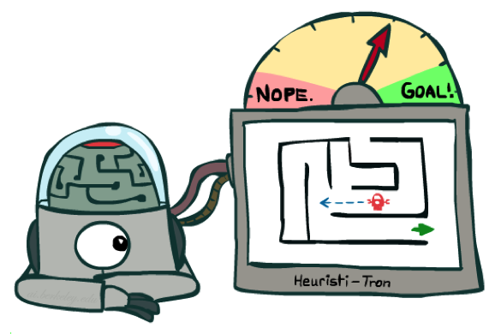
Search heuristics in informed search
10
5
11.2
from slides CS106

Slide 70
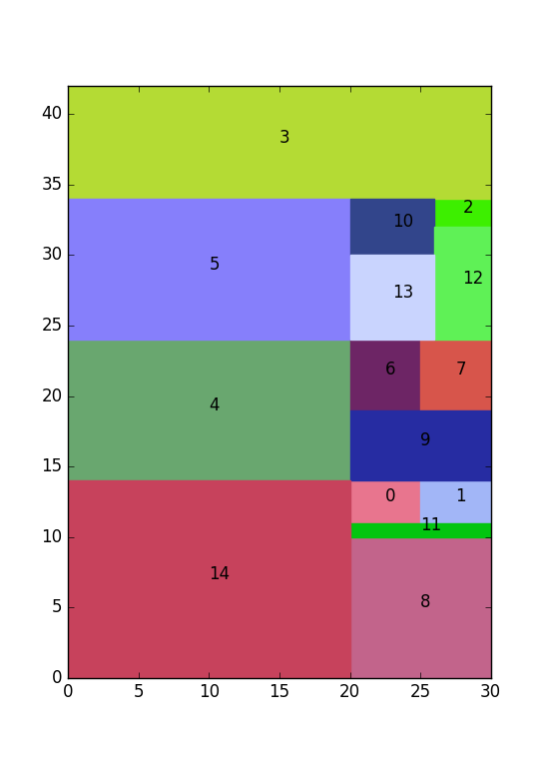
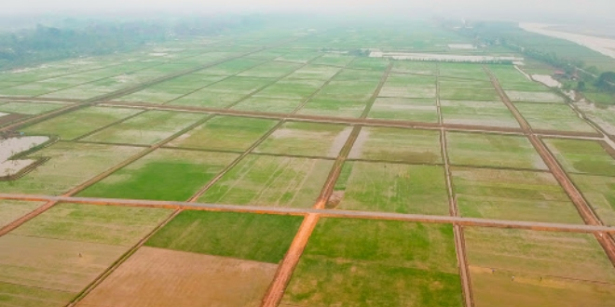
2d strip packing problem

Slide 71

One big rectangle with fixed sides
2d strip packing problem
$n$ small polygons with fixed area

Slide 72

Divide a big rectangle satisfied:
2d strip packing problem
Rectangles' perimeter are $min⁡$
Perimeter of the rectangle with the largest perimeter is min
The ratio between 2 sides of the rectangle sharing the biggest ratio is min

Slide 73

Compare 2 images
from slides CS231

Slide 74
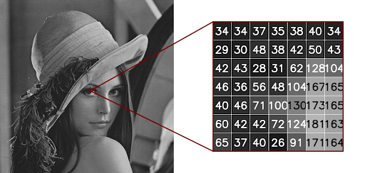
Compare 2 images
from slides CS231

Slide 75
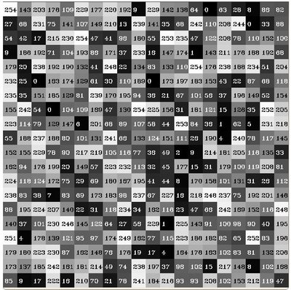
Compare 2 images
from slides CS231

Slide 76
Compare 2 images
from slides CS231

Slide 77
quiz

Slide 78
Give $n$ $(2 ≤ n ≤ 100,000)$ point on a plane, find one pair with the minimum distance
homework

Slide 79
Phân công công việc
 | Bùi Trí Dũng (Nhóm trưởng) | Phạm Ngọc Tân | Võ Khánh An
MSSV | 19521386 | 19520925 | 19520007
Công việc | Sửa bài tập về nhà Thuyết trình Chuẩn bị bài tập Chuẩn bị Kahoot | Làm slide Soạn bài tập về nhà Chuẩn bị tài liệu Thuyết trình | Chuẩn bị Kahoot Thuyết trình Chuẩn bị tài liệu Chuẩn bị bài tập
Mức độ hoàn thành | 100% | 100% | 100%

